Slide 1
THE ATOM
Our Introduction to Biochemistry

Slide 2
Here’s What Matters
Matter
Anything that takes up space
Found in 3 states
Solid
Liquid
Gas
(rarely plasma)

Slide 3
The Atom:
The basic unit of matter:
The atom
Incredibly tiny particle
Fun fact: there are more atoms in a teaspoon of water than there are teaspoons of water in all the oceans!!!
Fun fact: your pinky finger is about 100,000,000 atoms wide!!!

Slide 4
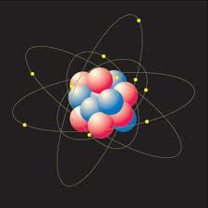

Slide 5
Proton

Slide 6
Proton
Neutron

Slide 7
Proton
Neutron
Electron

Slide 8
Proton
Neutron
Electron
Nucleus

Slide 9
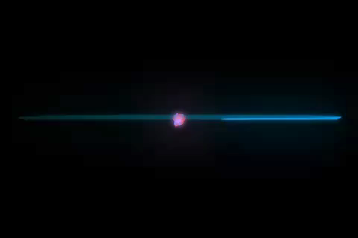

Slide 10
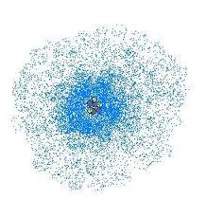
The Parts
Nucleus
Center mass of atom
Proton
Positively (+) charged particle found in nucleus
Mass of 1 amu
Neutron
Neutral particle found in nucleus
Mass of 1 amu
Electron
Negatively (-) charged particle found orbiting/circling nucleus in an “electron cloud”
No mass!

Slide 11
Elements
If you have a substance made up of only one kind of atom, you have an element
EX: gold is an element – a pure substance made up of the same atoms (gold atoms)
There are over 100, but not all occur naturally, and only 25 are found in living things, and only 4 make up the majority of living tissue
Carbon, Hydrogen, Oxygen, Nitrogen

Slide 12
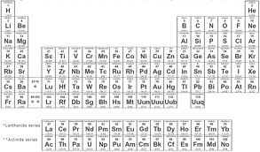
Elements
Elements are assigned symbols (one or two letters) and organized on the Periodic Table of the Elements

Slide 13
Elements
Elements are assigned symbols (one or two letters) and organized on the Periodic Table of the Elements
There is the
element “gold”
with the symbol
“Au”

Slide 14
Terms:
Atomic #
Mass #
Average Atomic Mass

Slide 15
Variations
Isotope
An atom with either more or fewer neutrons than the “typical” or “average” atom
Let’s look at the Atoms Packet again
Ion
An atom with either more or fewer electrons than the neutral form
This results in the atom being charged
Let’s look at the Atoms Packet again

Slide 16
Subatomic Particle Practice
If we are familiar with subatomic particles, and variations of “normal” atoms, we can use fragmented information to uncover all we need to know about an atom.
Let’s look at the Subatomic particle chart

Slide 17
Bonding
In an “effort” to become more stable, atoms of the same or different elements may chemically combine, or come together

Slide 18
Bonding
Molecule: any 2 or more atoms chemically combined (put together)
Cl
H
H
Cl
H
H
O

Slide 19
Bonding
Compound: any 2 or more atoms of different elements chemically combined (put together)
H
H
Na
O
Cl

Slide 20
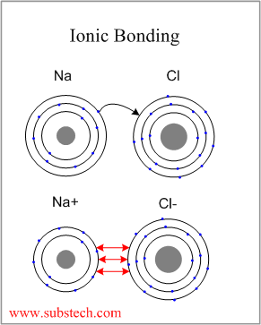
Ionic Bonding
An electron is transferred from one atom to another, resulting in two oppositely charged atoms.

Slide 21
Covalent Bonding
Two atoms share one or more pairs of electrons
This is the kind of bonding we see in the molecules we will study in biology!

Slide 22
Covalent Bonding
We will see covalent bonds in the kinds of molecules we will study called organic compounds
A compound that contains the element carbon
Organic compounds can also contain hydrogen, oxygen, and nitrogen

Slide 23
Covalent Bonding
How many covalent bonds can different atoms make?
The # of covalent bonds is based on how many more electrons an atom “wants”
Result:
Carbon makes 4 bonds, Nitrogen makes 3 bonds, Oxygen makes 2 bonds, and Hydrogen makes 1 bond

